Slide 1
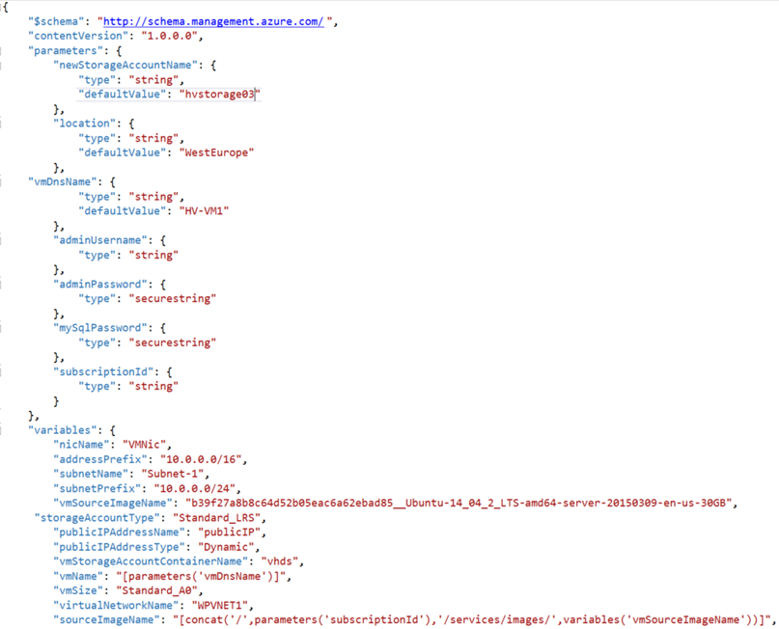

athenahealth FHIR Hackathon
Azure Serverless
Functions, CosmosDB, FHIR, and more…
March 25th - 26th , 2018
Peter Laudati
Gino Filicetti
Shawn Weisfeld
Tom Petreca
Cloud Solution Architects

Slide 2
Kick Off Agenda
Welcome & Intros
How all of this will work
Kick off & squad formation
Technology overview
Hands on Challenges & team learning!
Notes:
Welcome to homeroom… where we take attendance and make all the announcements, say the pledge of allegiance, etc.

Slide 3
athenahealth FHIR Hackathon
Welcome & Intros
Gino Filicetti
Peter Laudati
SME – Azure IaaS
SME – Azure IaaS
Tom Petreca
Shawn Weisfeld
SME – Azure IaaS
SME – Azure IaaS
Notes:
Bem vinda! Bienvenidos!
Welcome to the OCP P20 Level UP! event
Olá! Meu nome é Peter Laudati
Eu sou djee Nova Jersey
Y por mis amigos de los otros paises,
Me llamo Peter. Soy de Neuva Jersey, y yo vivo circa de Neuva York.

Slide 4
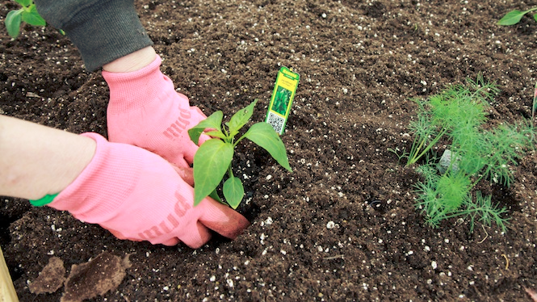
You will get your hands dirty

Slide 5
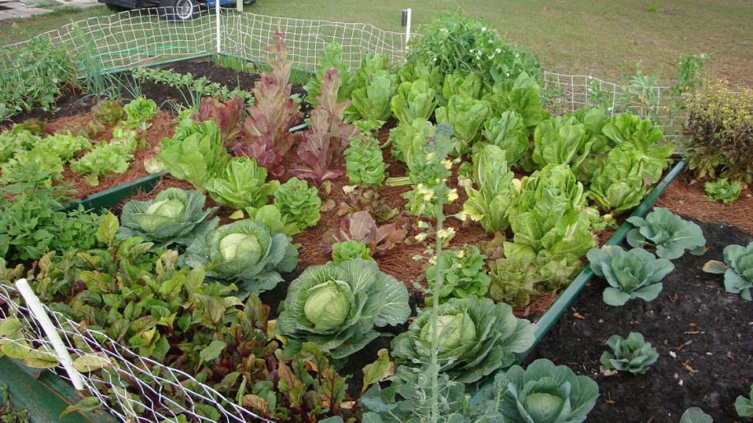
*results may vary
Notes:
You might not grow a garden like this… but at least you can learn while trying.

Slide 6


Slide 7

Logistics

Slide 8

Logistics Food
Notes:
Plenty of food… all of the time…
Breakfast – “Pre-function 3”
Mid-morning Snacks
Lunch – “Pre-function 3”
Afternoon Snacks
COFFEE – ALL DAY!!!
Dinner – Washington 2, 3, & 4
Dinner upstairs today and Wednesday. Thursday will be slightly different…

Slide 9
Objectives
What to Expect:
Deep dive into ARM templates & DSC
Overview of Azure Dev Test Labs
Hands on work, lab exercises to:
Create real ARM templates and using them for IaC automated deployments
Create dev test lab environments to provision environments created from these templates.
Intended Outcomes:
Athena participants will walk away with:
Ability to write nested & chained ARM templates
Ability to Build/Deploy composite DSC resources
Templates created from Infrastructure as Code lab exercises
A deeper understanding of Dev Test Labs
Integration with CI/CD pipeline to automate image builds & deployments

Slide 10
Agenda Monday & Tuesday
PowerPoint Overview
Iterative hands on challenges
Breaks for food and stretching
More team challenges
Sharing & recaps throughout the day

Slide 11
Challenge #0 Get your machines ready!
Install Windows Subsystem for Linux (Bash Shell)
Install the Azure CLI (V2)
Install PowerShell Cmdlets for Azure
Install Visual Studio Code
Install ARM Template plugins for VS Code
ARM Tools
ARM Snippets
Install Azure Storage Explorer
Notes:
If you have a Mac… great! You’re already a step ahead.
If not, get your Windows box loaded up with all the tools that work well in the OSS world!

Slide 12

And now death by Power Point… (for an hour or so)

Slide 13
Azure “mini” Overview Review

Slide 14
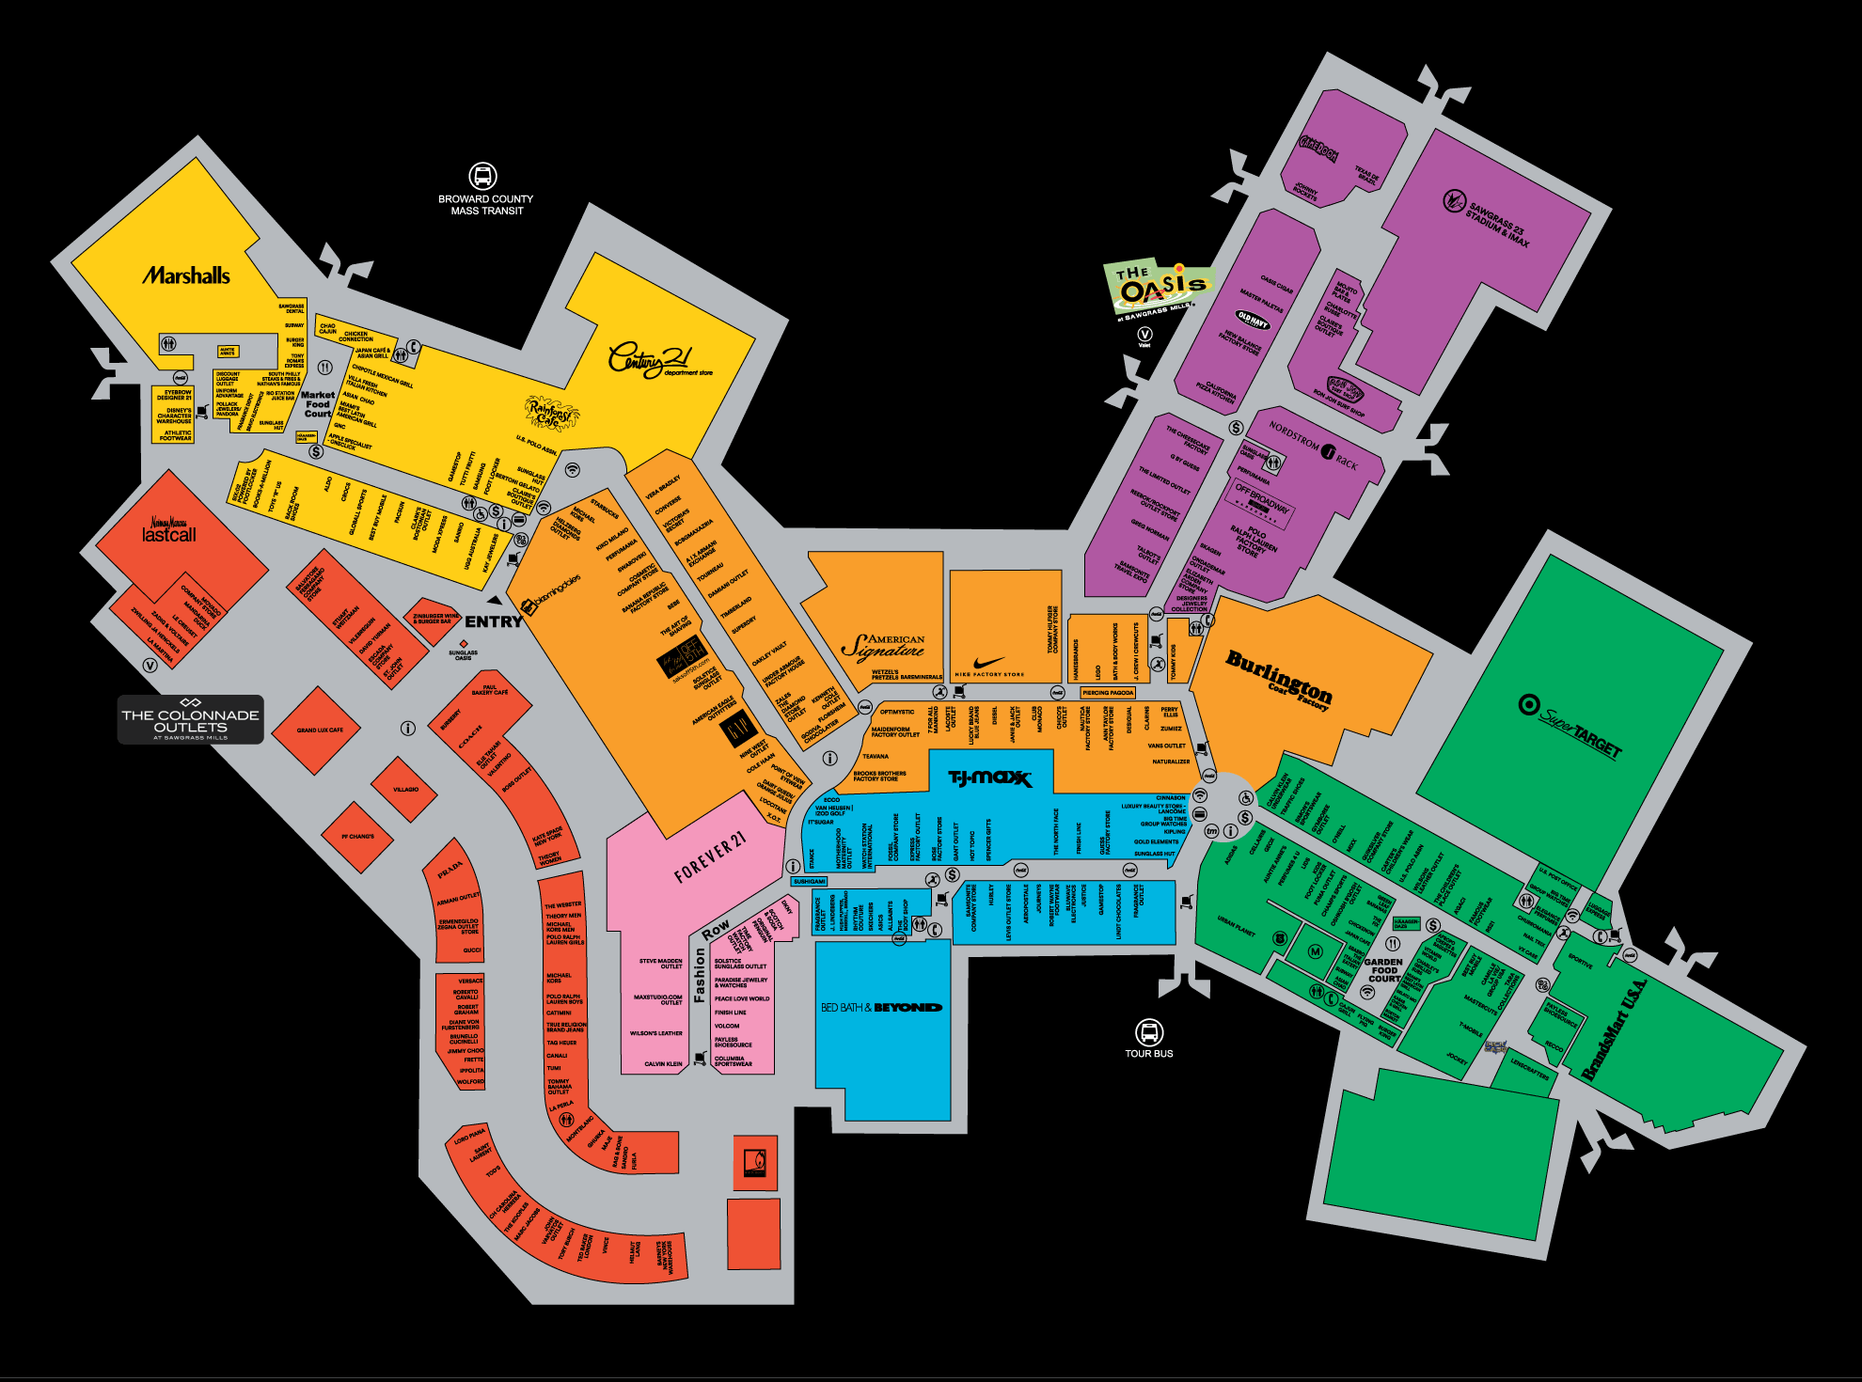
Compute

Slide 15





Azure: The Power Of Choice
Compute
Virtual Machines
Container Service
Service Fabric
App Service
Functions
More Control
Focus on the App
Customer-managed
(IaaS)
Platform-managed
(PaaS)
Code-only
(serverless)
Notes:
Azure provides several cloud-based compute offerings to run your application so that you don't have to worry about the infrastructure details.
You can easily scale up or scale out your resources as your application usage grows. Azure offers services that cover the spectrum—from providing infrastructure-as-a-service (IaaS) to give you full control over your application hosting, through platform-as-a-service (PaaS) where the services are hosted for you, to true serverless hosting where all you need to do is write your code.

Slide 16
Compute
IaaS VMs
VM Scale Sets
Batch
Logic Apps
Functions
App Service
Azure Container Service
Azure Container Instances
Service Fabric
Cloud Services
SERVERS!
SERVERLESS!
https://aka.ms/comparecompute

Slide 17

High Availability
Notes:
Hola. Mi nombre es Inigo Montoya. Mataste a mi padre. Prepárate para morir.

Slide 18


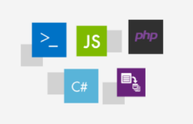
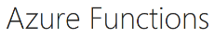




Slide 19

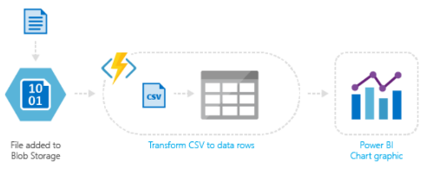
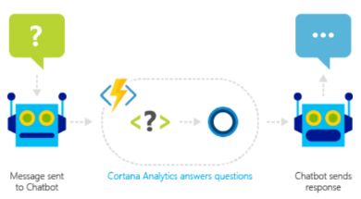
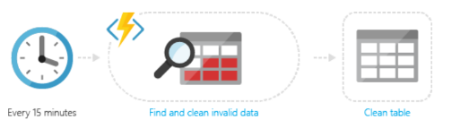

Slide 20
FHIR Service

Slide 21
Azure Event Hubs

Slide 22
Azure Cosmos DB

Slide 23
Azure Search

Slide 24
Azure Resource Manager Overview

Slide 25




Azure structure
Account and enterprise agreement
Subscription(s)
Resource group
Resource group
SQL
SQL
Role-based access control
Tags
Azure Resource Manager policy
Templates
Notes:
Presentation notes:
Key concepts:
Resource groups: application lifecycle boundary; container that holds resources.
Resources: web apps, Azure SQL Database, storage account, network, and so on…almost everything.
RBAC (role-based access control): User groups with role permissions assigned to resource groups.
Tags: Key value pairs assigned to resources or resource groups.
Policy: Restrictions on resources; for example, we can enforce mandatory tags per resource type.
Templates: JSON (JavaScript Object Notation) defining deployment and configuration of your application.
Slide objective:
Explain the hierarchy of the Azure model and key concepts.
Speaker notes:
When we talk about how we’ve done our Azure structure, we think about subscriptions. You want to lay out your subscriptions based on technology, the type of policy that you want to apply, and how your business is laid out. We use RBAC, which is role-based access control, to ensure that the right people have the right access to the right subscriptions. We want to make sure that people can operate their business, information remains protected, and people can’t make changes when they’re not supposed to.
The lower level is the concept of the resource group, an Azure construct that allows you to put the various resources associated with a single app into a resource group and then apply policy from Azure Resource Manager and tags. We use tags—key-value pairs—in Microsoft IT to identify the organization that it’s related to, the environment, and the app ID, a unique identifier. We can use these tags to associate different resources to a different app, organization, or environment, and then make business decisions based on that. Resources include web apps, Azure SQL Database, storage account, and so on.
Templates: We’ve created specific templates that internal teams can use to build out resources, and we ensure that they build them out according to our standards and policies. Templates enforce the creation of tags for tracking.

Slide 26
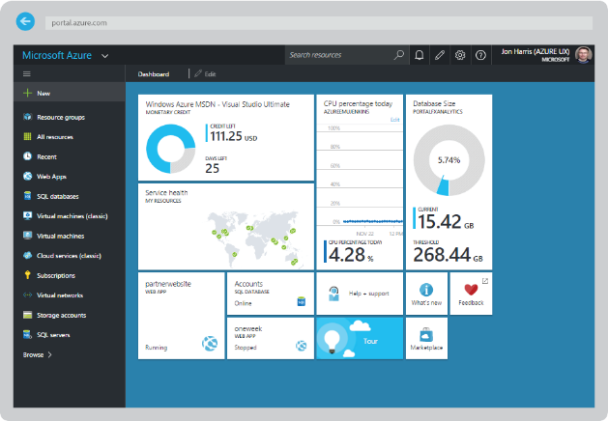
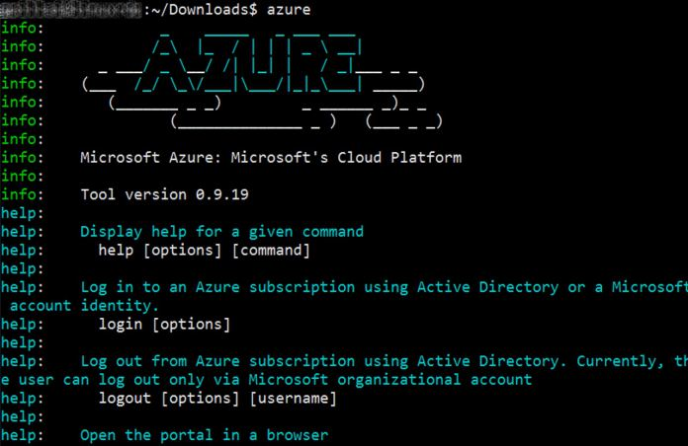
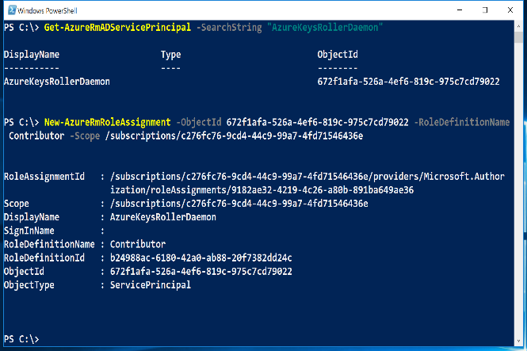

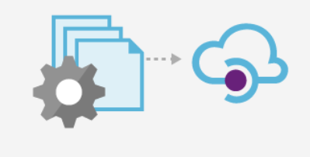
Azure Portal
Azure CLI
Azure PowerShell
Azure Resource Manager
Tenant
Tenant
Azure API
Subscription
Subscription
Subscription
Resource Group
Resource Group
Resource Group
Resource Group

Slide 27
Resource Providers
Web Site
Storage
Individual resources
Provision resources in isolation
Deployment becomes more complex
Management of app is challenging
Proper use of resources becomes more abstract
Isolation makes communication a challenge
Database
Virtual Machine

Slide 28
Resource Groups
Logical groups of multiple resources of similar or different types
Every resource must be in a resource group, cannot be in more than one
Resources inside resource group may span across regions
Resource Group has a location for storing metadata
RESOU
R
CE G
R
OUP

Slide 29
Resource Group Lifecycle
Question:
Should these resources be in the same group or a different one?
Hint:
Do they have common lifecycle and management?
Answer:
Up to you.

Slide 30
Scripting vs Declarative
PowerShell or Azure CLI
Sequential code calling commands to create the infrastructure.
ARM Templates
A JavaScript Object Notation (JSON) file that defines one or more resources to deploy to a resource group. It also defines the dependencies between the deployed resources. The template can be used to deploy the resources consistently and repeatedly.
declarative syntax - Syntax that lets you state "Here is what I intend to create" without having to write the sequence of programming commands to create it. The ARM template is an example of declarative syntax.

Slide 31
Creating a template
Visual Studio
Resource Group project type contains a UI to help add resources to a template
Intellisense helps you spot syntax errors and tips on schema definition
Visual Studio code
No IDE, but can be configured for ARM template usage through an extension
Quickstart templates
https://github.com/Azure/azure-quickstart-templates
Export Template from existing Resource Group
To duplicate or slightly modify an existing template

Slide 32
The template
Structure and elements
{
"$schema": "http://schema.management.azure.com/schemas/2015-01-01/deploymentTemplate.json#",
"contentVersion": "",
"parameters": { },
"variables": { },
"resources": [ ],
"outputs": { }
}
Declarative syntax
Allows you to declare the resources you want to have without having to write the script sequence of commands required to create it.

Slide 33
The template - Parameters

Slide 34
The template - Parameters
Minimize parameters
Too many parameters may confuse the user
Use the “metadata” to describe the parameter
This can help the user identify how and where the value will be used
Define default values
Setting default values guides user and reduces chances of invalid values
Parameters are mandatory, use default value to “make it optional”
Use securestring type
Passwords and secrets should use the securestring type

Slide 35
The template - Variables
"variables": {
"storageAccountName": "[concat(uniquestring(resourceGroup().id), 'sawinvm')]",
"nicName": "myVMNic",
"subnetRef": "[resourceId('Microsoft.Network/virtualNetworks/subnets', parameters('virtualNetworkName'), parameters('subnetName'))]",
"environmentSettings": {
"test": {
"instancesSize": "Small",
"instancesCount": 1
},
"prod": {
"instancesSize": "Large",
"instancesCount": 4
}
}
}

Slide 36
The template - Variables
Easier to read and edit
It can simplify your template, making it easier to read
Complex objects
Group variables into an object helps understand the template design
Custom values
Use expressions and functions to modify parameter values and construct new values

Slide 37
The template - Resources
{ "type": "Microsoft.Storage/storageAccounts",
"name": "[variables('storageAccountName')]",
"apiVersion": "2016-01-01",
"location": "[resourceGroup().location]",
"sku": {
"name": "Standard_LRS"
},
"kind": "BlobStorage",
"properties": { "accessTier": "Hot" }
},
{ "type": "Microsoft.Storage/storageAccounts",
"name": "[parameters('storageAccountName')]",
"apiVersion": "2015-06-15",
"location": "[resourceGroup().location]",
"properties": {
"accountType": "Standard_LRS"
}
}

Slide 38
The template - Resources
Use “comments”
Use this tag to help others understand the purpose of the resource
ApiVersion
This property value will define the structure of the “properties” section of the resource
Hard-code it on the resource, so Visual Studio Intellisense can recognize it
Protected Settings
Use this property to pass secrets if the resource type supports it

Slide 39
How to Deploy an ARM template
Powershell
New-AzureRmResourceGroupDeployment -Name ExampleDeployment -ResourceGroupName ExampleResourceGroup -TemplateFile <PathToTemplate> -
Azure CLI
azure group deployment create -f "c:\MyTemplates\example.json" -g examplegroup
-n exampledeployment
REST API
PUT /subscriptions/{subscriptionId}/resourcegroups/{resourceGroupName}/providers/Microsoft.Resources/deployments/{deploymentName}?api-version=2016-09-01
azure group deployment create -f "c:\MyTemplates\example.json" -g examplegroup
-n exampledeployment

Slide 40
Debugging…
Code Editors
Resource Explorer
Deployment output
Resource Group Deployments
Activity Logs
VM Extension Logs

Slide 41
Template Tools ( http://aka.ms/azuretools )
Visual Studio
Visual Studio Code
PowerShell / CLI
VSTS
https://docs.microsoft.com/en-us/azure/azure-resource-manager/resource-group-template-functions
https://docs.microsoft.com/en-us/azure/templates/

Slide 42
Challenge #1 Create a “Hello World” template
Create storage account via a template
Use some parameters
Deploy it from PowerShell
Tear it down
Deploy it from Azure CLI

Slide 43
Networking in Azure @ athenahealth Don’t do the following at home!
VNets and most networking tasks will be handled by the cloud infrastructure team
You will be “given” a network to deploy resources into most of the time.
This is so you don’t break things!
We will be doing the next set of challenges with network resources because they are quick to deploy!

Slide 44
Challenge 2 Deploy a simple network stack
Insert from proctor guide…

Slide 45
Challenge 3 Add some complexity to the network…
Insert from proctor guide…
Hint: Use some of the advanced functions you just learned about! ☺

Slide 46
ARM Advanced Feature: linked templates

Slide 47
ARM Templates & The Web
Templates pull other templates and resources from an HTTP endpoint
Normally integrated with Git repos
Common to use Azure Storage with SAS token
Example of what needs to live where…

Slide 48
deployment()…deployment functions
Returns information about the current deployment but most useful for linking another template to the current template
Linked templates cannot be local. Use a storage account or git repo
You can pass parameters directly to the linked template as you would the parent template
Useful for “separation of duties” (e.g. network team responsible for network templates, etc)
{
"type": "Microsoft.Resources/deployments",
…
}
https://docs.microsoft.com/en-us/azure/azure-resource-manager/resource-group-template-functions-deployment

Slide 49
